Slide 1
Travel Yes or NO?
Travel Bookings

Slide 2
TEAM HYDRA
Swati Gupta
Sharanu Ullagaddi
Alok Senapati
Prashanth Kumar SB
Deepak Kumar Kota

Slide 3
How do different consumer segments behave when they come across various touchpoints?
In order to shed light to the main question, the following sub-questions are to be answered:
What is the effect of CICs on booking conversions?
Which are the consumer segments who engage in CICs and convert?
Can a firm-initiated contact make customers who have engaged in customer-initiated contacts with competitors, make them shift consideration?
Which segments are more likely to do so?

Slide 4
Understanding:
CIC’c : Customer Initiated Contact’s.
FIC’s : Firm Initiated Contact’s.
Conversion: Leading to purchase.
Time spent on site: Zero for FIC’s and Non Zero for CIC’s
Customer Segment: Various segment of customer like rich or poor.
Focus Audience: Group of customer leading to conversion i.e is leading to purchase of product(Travel Tickets)

Slide 5
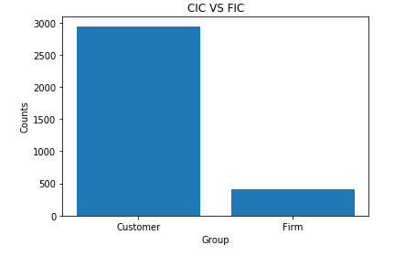
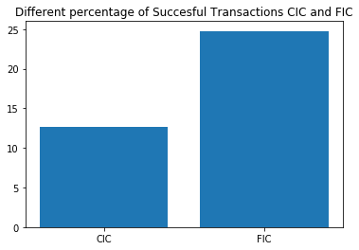
What is the effect of CICs on booking conversion?
To describe an effect of CIC’s on Conversion we should compare it with FIC’s.
Graph:
X-Axis: Group of Initiated contact, CIC’s and FIC’s.
Y-Axis: Count of customer who are converting the browsing into purchase.
Inference: CIC’s if more compared to FIC’s

Slide 6
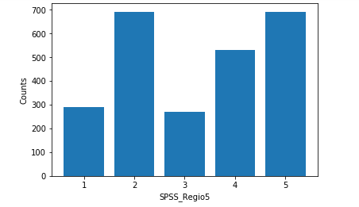
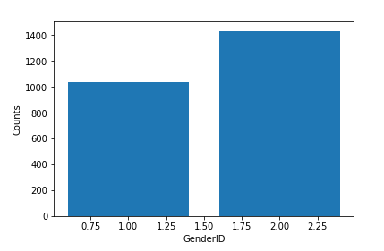
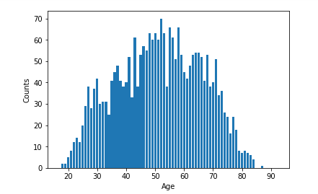
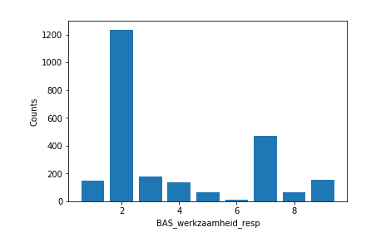
Which are the consumer segments who engage in CICs and convert?
1: Amsterdam, Rotterdam, Den Haag
2: West (1 excluded)
3: North
4: East
5: South
1: Male, 2: Female
Age in years
1: entrepreneur
2: salaried employment
3: working for the governent
4: incapacitated
5: unemployed / job seeker
6: social assistance benefit
7: (early) retirement
8: student/scholar
9: housewife/houseman/other

Slide 7
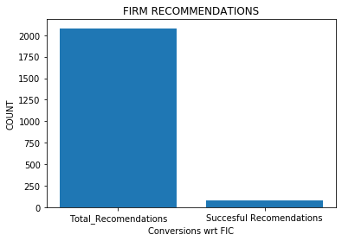
Can a firm-initiated contact make customers who have engaged in customer-initiated contacts with competitors, make them shift consideration?
X-Axis: Conversion WRT FIC.
Y-Axis: Count of Customers.

Slide 8
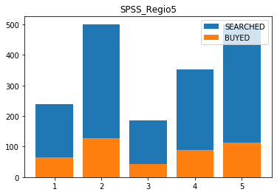
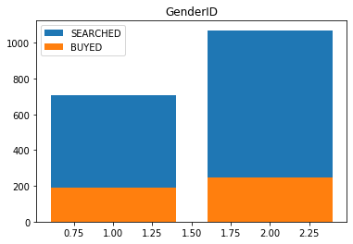
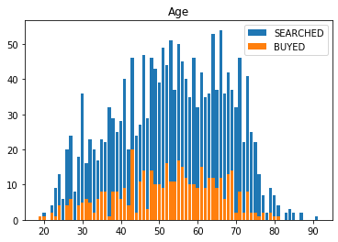
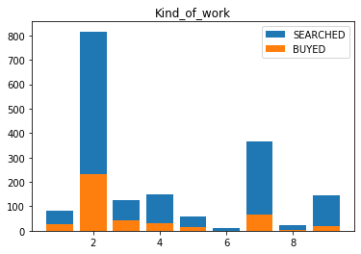
Which segments are more likely to do so?
1: Amsterdam, Rotterdam, Den Haag
2: West (1 excluded)
3: North
4: East
5: South
1: Male, 2: Female
Age in years
1: entrepreneur
2: salaried employment
3: working for the governent
4: incapacitated
5: unemployed / job seeker
6: social assistance benefit
7: (early) retirement
8: student/scholar
9: housewife/houseman/other

Slide 9
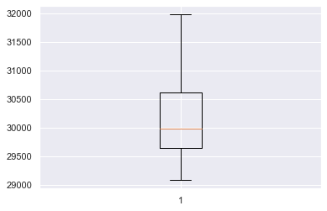
An insight from the time a person spending on a product when he buys that product
If a person is spending time within this range an not buying it yet
Then we can send him customer initiated Contact Since the buying chances are high
UB=32070
LB=28669

Slide 10

Conclusion:
Until an Customer feels to buy, Purchases doesn't happen.
Very Less Firm initiated purchase are recorded with respect to the dataset.
CIC’s are more compared to all the FIC’s.
HAIL HYDRA

